Slide 1

Computer Science and the Future
Akash Singh and Émilie Mayodon

Slide 2

Introduction
The future, employment, and salaries
Business and company needs
Impact on our everyday lives
Ethical dilemma on privacy

Slide 3
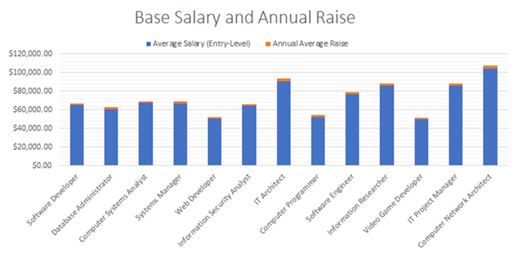
Careers and salaries
Jobs | Average Salary (Entry-Level) | Annual Average Raise
Software Developer | $65,000.00 | $1,690.00
Database Administrator | $61,000.00 | $1,586.00
Computer Systems Analyst | $67,460.00 | $1,753.96
Systems Manager | $67,000.00 | $1,742.00
Web Developer | $51,000.00 | $1,326.00
Information Security Analyst | $64,600.00 | $1,679.60
IT Architect | $91,000.00 | $2,938.00
Computer Programmer | $52,000.00 | $2,531.10
Software Engineer | $77,000.00 | $2,002.00
Information Researcher | $86,000.00 | $2,236.00
Video Game Developer | $50,276.00 | $1,307.18
IT Project Manager | $86,126.00 | $2,239.28
Computer Network Architect | $104,650.00 | $2,720.90
Canadian Annual Interest Rate |  | 2.60% (2019)
The following diagram demonstrates the starting salary of common careers in the Computer Science Field, and its annual average raise
The current Canadian annual average salary increase is 2.60%, this leads to a greater pay growth. Jobs with a generally high demand tend to receive a bigger annual increase.
As shown, computer network architect has the highest paying job with a high annual increase, while video game developer, statistically, is the lowest paying job.

Slide 4
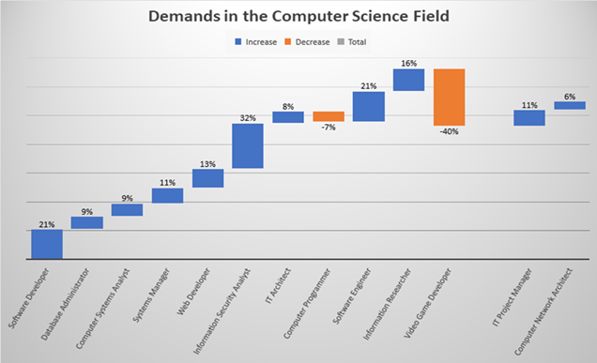
Degrees and Demands
Jobs | Degree Required | Demands
Software Developer | Bachelor's Degree | 21%
Database Administrator | Bachelor's Degree | 9%
Computer Systems Analyst | Bachelor's Degree | 9%
Systems Manager | Bachelor's Degree | 11%
Web Developer | Associate | 13%
Information Security Analyst | Bachelor's Degree | 32%
IT Architect | Bachelor's Degree | 8%
Computer Programmer | Bachelor's Degree | -7%
Software Engineer | Bachelor's Degree | 21%
Information Researcher | Master's Degree | 16%
Video Game Developer | Bachelor's Degree | -40%
IT Project Manager | Bachelor's Degree | 11%
Computer Network Architect | Bachelor's Degree | 6%
This waterfall chart shows the current percentage of demands for a list of common jobs in the Computer Science Field.
Unfortunately, video game developers are in high decrease of demands, while information security analyst is soaring in demands.

Slide 5
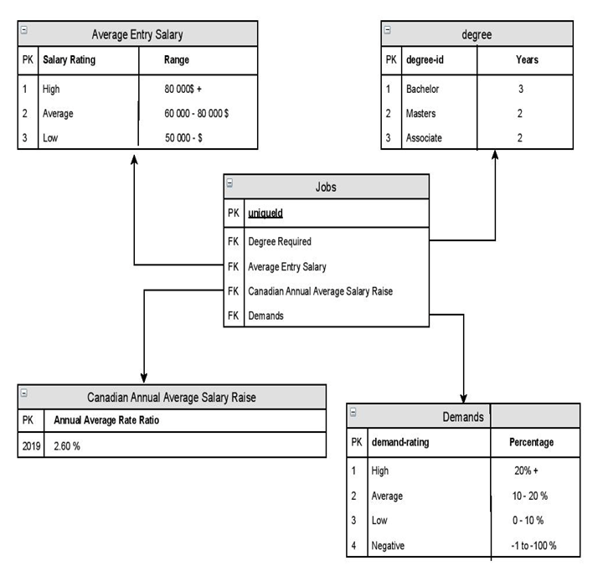
ER Diagram

Slide 6

Ethical Dilemma: Online Privacy
 | Gains | Losses
Public | Public recognition (fame) Express oneself Entertainment purposes Way to distract oneself from other problems | Intruding personal life Cyberbullying Leak of private information/photos Circulation of fakes news Trace everything back to you
Government | Stop online trafficking of photos Tracking potential criminals | Total surveillance of citizens (Big Brother, Edward Snowden) Loss of public trust

Slide 7
Ethical Dilemma: Online Privacy
Duties | Public | Government
Public | Report share of unwanted private information Don’t cyberbully Think twice before posting online Check the reliability of the sources | Report scams and cyber crimes
Government | Be honest about the surveillance system Provide a safe place | Filter what should be watched and registered

Slide 8

Conclusion
Different paths
Ethical topics

